Slide 1
Distributed Hash Table (DHT)
Notes:
Share something about distributed hash table. At first, , I will introduce traditional hash table and dht
And then,I will show an example of dht for storage and retrieval. Finally, there are the two points and application of DHT.

Slide 2
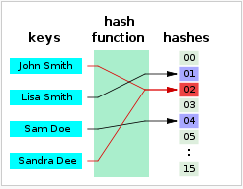
Traditional Hash Table
In computing, a hash table (hash map) is a data structure which implements an associative array abstract data type, a structure that can map keys to values. A hash table uses a hash function to compute an index into an array of buckets or slots, from which the desired value can be found.
hash function : hash(KEY) = index
Notes:
traditional hash table is familiar to us. We learn it from data structure lesson. In wiki, its description as follows:
hash function expression like this : it uses key as an input ,and index of desired value as the output.
If known a given key and a hash function ,we can easily get an index. And then using the index to find the desired value.

Slide 3
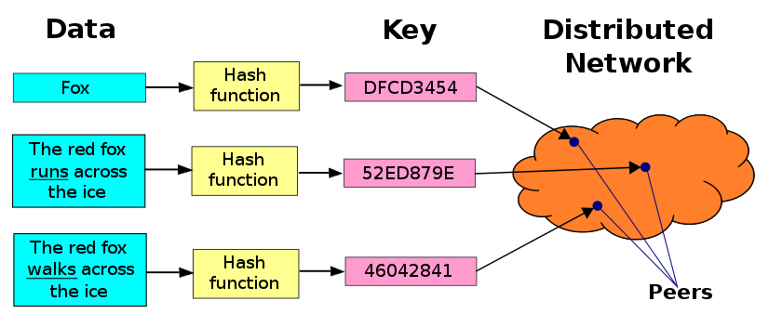
Distributed Hash Table
A distributed hash table (DHT) is a class of a decentralized distributed system that provides a lookup service similar to a hash table: (key, value) pairs are stored in a dht, and any participating node can efficiently retrieve the value associated with a given key.
Notes:
Distributed hash table is the extension of traditional hash table in distributed system.
it is a network model to improve and perfect the peer to peer network .

Slide 4
The DHT for Storage and Retrieval
Step1: using filename as hash function input to produce a key k.
Step2: a message put(k, data) is sent to any node participating in the DHT.
Step3:The message is forwarded from node to node through the overlay network until it reaches the single node responsible for key k .
Step4:That node then stores the key k and the data.
Any other client can then retrieve the contents of the file by again hashing filename to produce k and asking any DHT node to find the data associated with k with a message get(k).
Notes:
Here is an example of distributed hash table for storage and retrieval.firstly,
Secondry,and then , finally … it’s the procedure of storage,
after one stores the file datas ,any other client can use filename for retrieval.
Here is the detail description.

Slide 5
Two Points Of dhts
(1) Each node only keeps partial information of DHT.
(2) Each node only stores partial datas.
Thus the addressing and storage in the whole network can be realized.
Notes:
Here are two points of dht, and it also is the difference between dht and traditional hash table .
One is … another is …

Slide 6
Where Can It Be Used?
DHTs form an infrastructure that can be used to build more complex services, such as anycast, cooperative web caching, distributed file systems, domain name services, instant messaging, multicast, and also peer-to-peer file sharing and content distribution systems.
Notes:
That’s all, thanks. Fault tolerance

